Slide 1
Critically reviewing the literature
Pravin Kumar
Professor, Dept. of Mechanical Engineering
Delhi Tchnological University

Slide 2
Reasons for reviewing the literature
To conduct a ‘preliminary’ search of existing material
To organise valuable ideas and findings
To identify other research that may be in progress
To generate research ideas
To develop a critical perspective

Slide 3
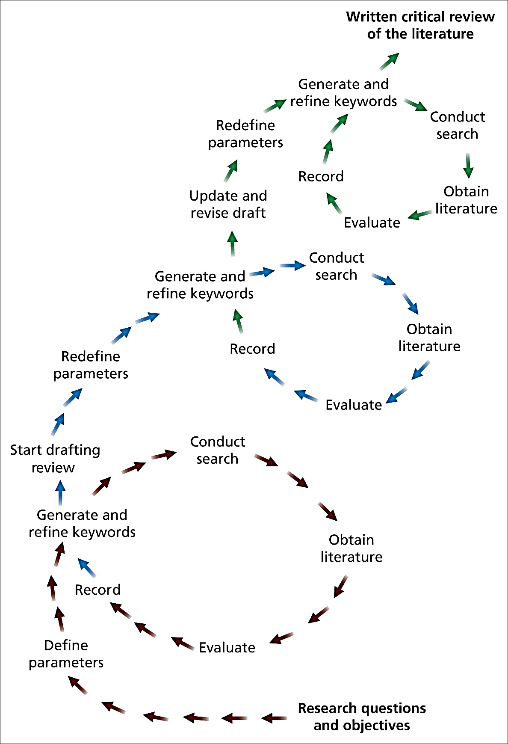
The literature review process
Figure 1 The literature review process

Slide 4
The Critical Review (1)
Approaches used
Deductive -
Develops a conceptual framework from the literature which is then tested using the data
Inductive -
Explores the data to develop theories which are then tested against the literature

Slide 5
The Critical Review (2)
Key purposes
To further refine research questions and objectives
To discover recommendations for further research
To avoid repeating work already undertaken
To provide insights into strategies and techniques appropriate to your research objectives

Slide 6
Adopting a critical perspective (1)
Skills for effective reading
Previewing
Annotating (Adding explanation or short opinion)
Summarising
Comparing and contrasting
Harvard College Library (2006)

Slide 7
Adopting a critical perspective (2)
The most important skills are
The capacity to evaluate what you read
The capacity to relate what you read to other information
Wallace and Wray (2006)

Slide 8
Adopting a critical perspective (3)
Questions to ask yourself
Why am I reading this?
What is the author trying to do in writing this?
How convincing is this?
What use can I make of this reading?
Adapted from Wallace and Wray (2006)

Slide 9
Content of the critical review
You will need to
Include key academic theories
Demonstrate current knowledge of the area
Use clear referencing for the reader to find the original cited publications
Acknowledge the research of others

Slide 10
Is your literature review critical?
Checklists Box 3.2 and Box 3.3
Complete the checklists to evaluate your literature review

Slide 11
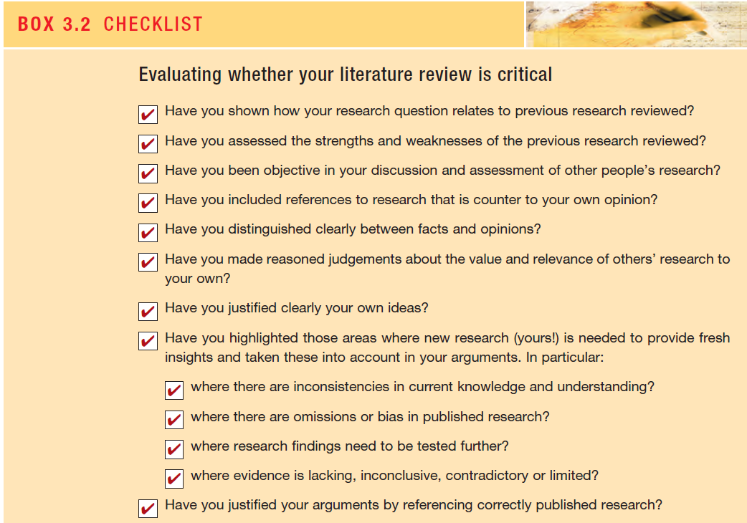

Slide 12
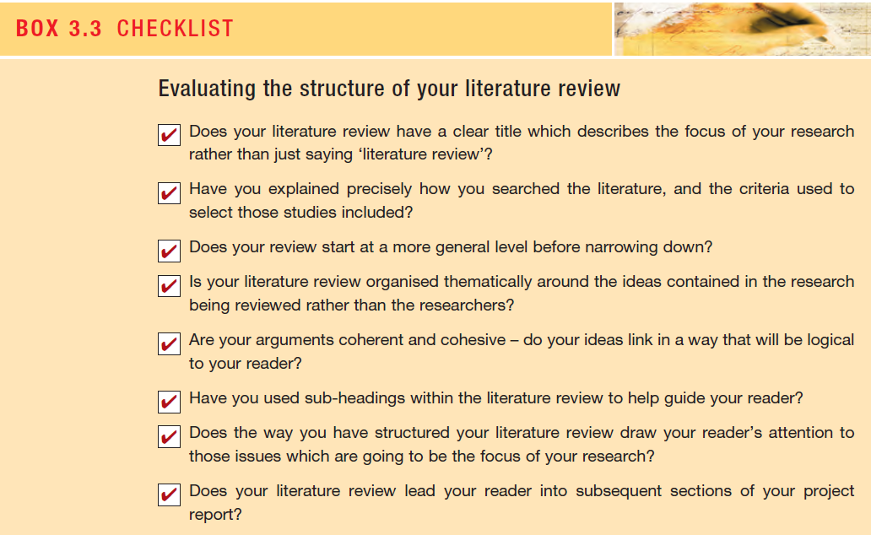

Slide 13
Structure of the literature review
Three common structures
A single chapter
A series of chapters
Throughout the report

Slide 14
The key to a critical literature review
Demonstrate that you have read, understood and evaluated your material
Link the different ideas to form a cohesive and coherent argument
Make clear connections to your research objectives and the subsequent empirical material

Slide 15
Categories of Literature Sources
Primary (published and unpublished)
Secondary
Tertiary
Detailed in Tables 3.1 and 3.2 Saunders et al. (2009)

Slide 16
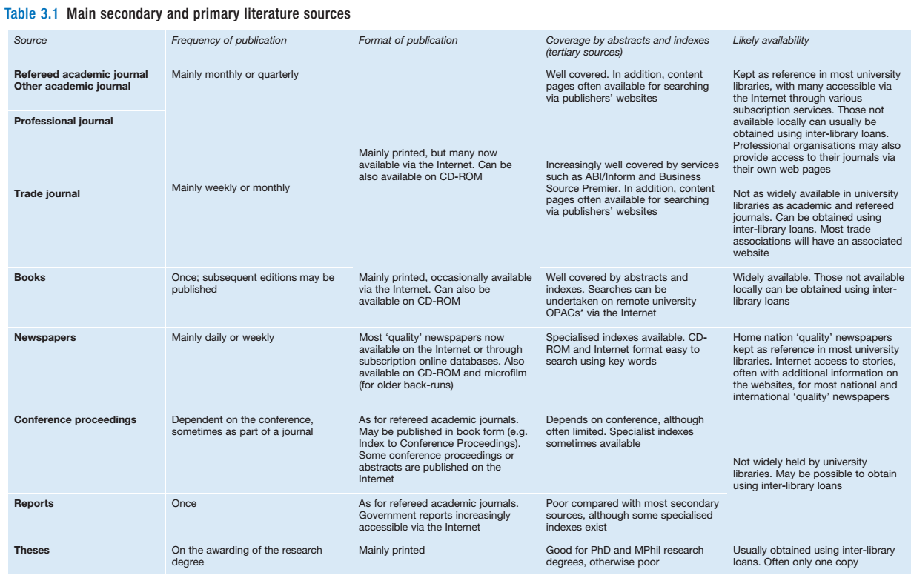

Slide 17
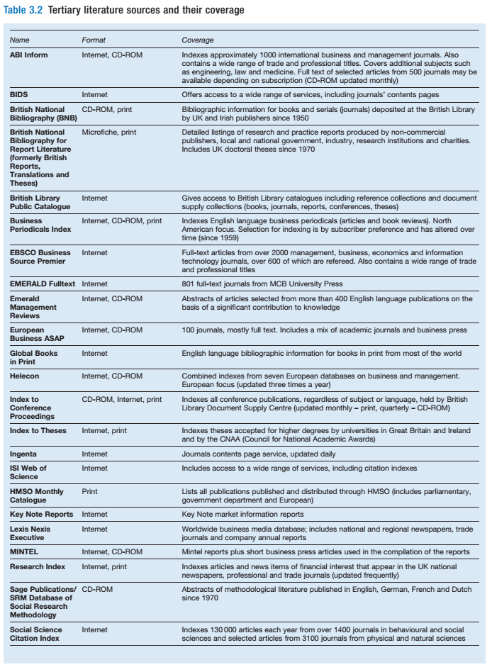

Slide 18
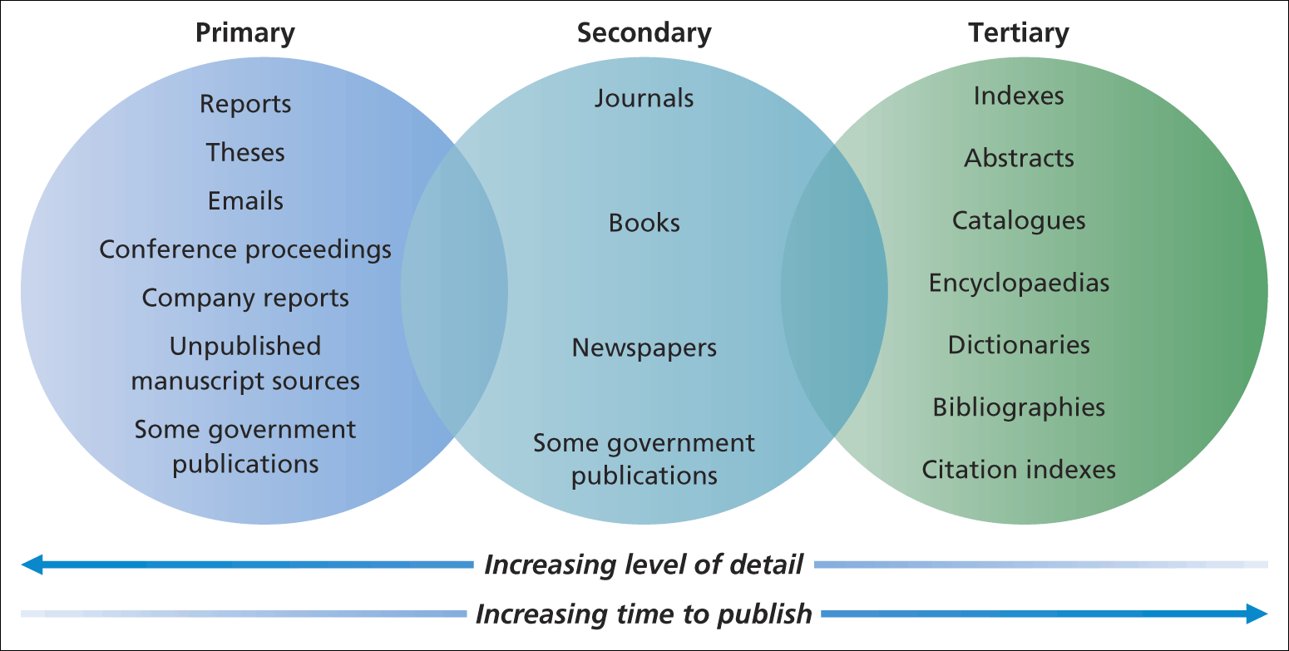
Literature sources available
Literature sources available
Figure 3.2 Literature sources available

Slide 19
The literature search strategy (1)
Write down
parameters of your search
key words and search terms to be used
databases and search engines to be used
criteria for selection of relevant and useful studies and discuss these with a tutor (if possible)

Slide 20
The literature search strategy (2)
Define the research parameters
Generate key words
Discuss your research
Brainstorm ideas
Construct Relevance trees - use computer software

Slide 21
Conducting a literature search (1)
Approaches can include
Searching tertiary literature sources
Obtaining relevant literature
Scanning and browsing secondary literature
Searching using the Internet

Slide 22
Conducting a literature search (2)
Searching using tertiary literature
Ensure key words match controlled index language
Search appropriate printed and database sources
Note precise details used – including search strings
Note the FULL reference of each search found

Slide 23
Conducting a literature search (3)
Printed sources
Databases – use of Boolean logic and free text searching (Table 3.3)
Scanning and browsing
Searching the Internet (Tables 3.4 and 3.5)
Saunders et al. (2009)

Slide 24
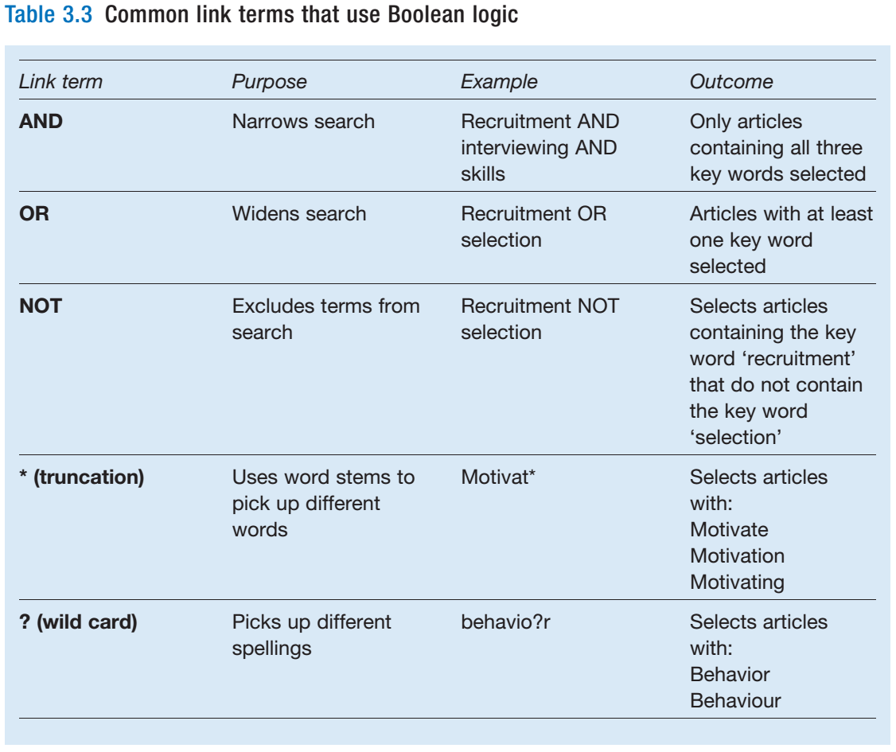

Slide 25
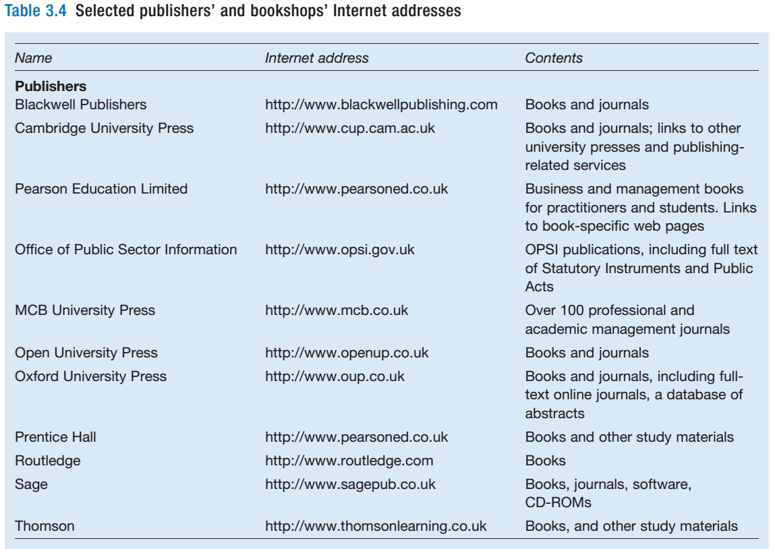

Slide 26
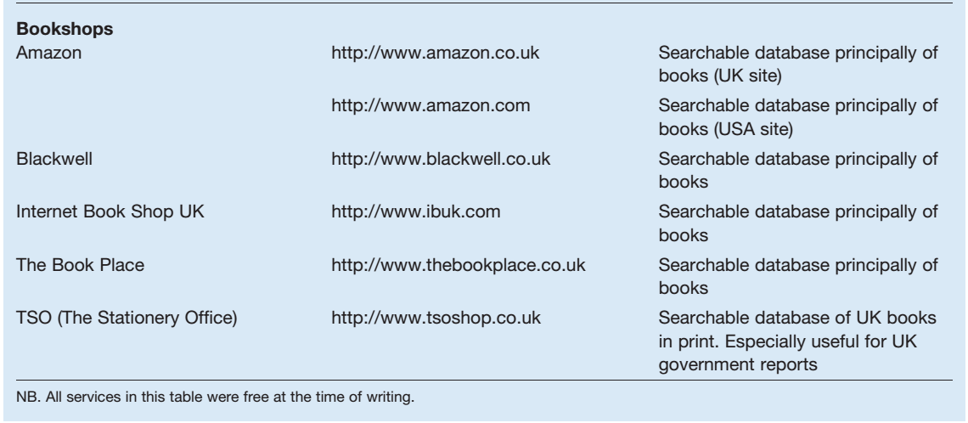

Slide 27
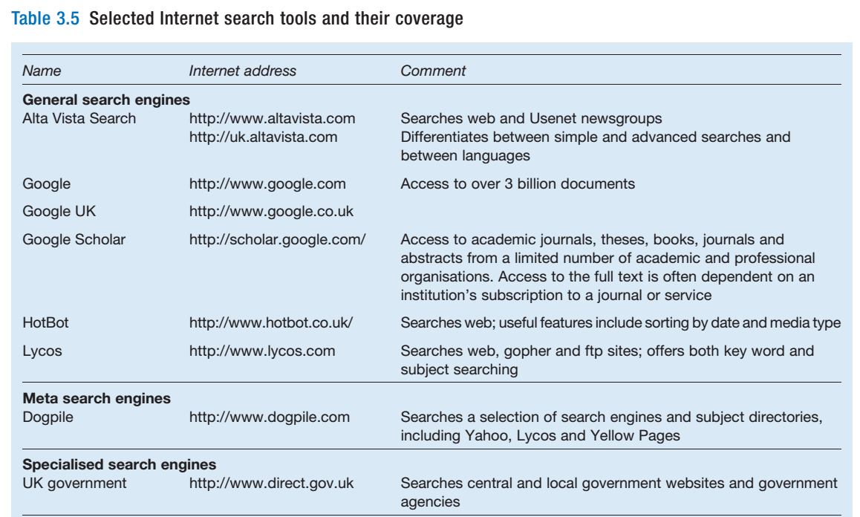

Slide 28
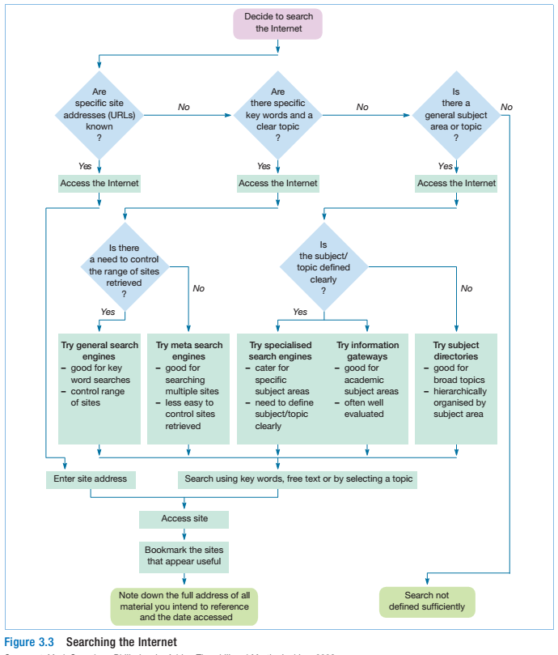

Slide 29
Evaluating the literature
Define the scope of your review
Assess relevance and value
Assess sufficiency

Slide 30
Recording the literature
Make notes for each item you read
Record –
Biographic details
Brief summary of content
Supplementary information
Sharp et al. (2002)

Slide 31
Recording the literature
Bibliographic details (Table 3.6)
Brief summary
Supplementary information (Table 3.7)

Slide 32
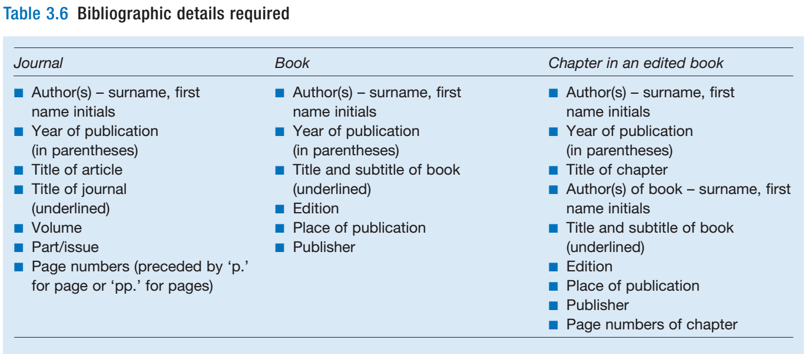

Slide 33
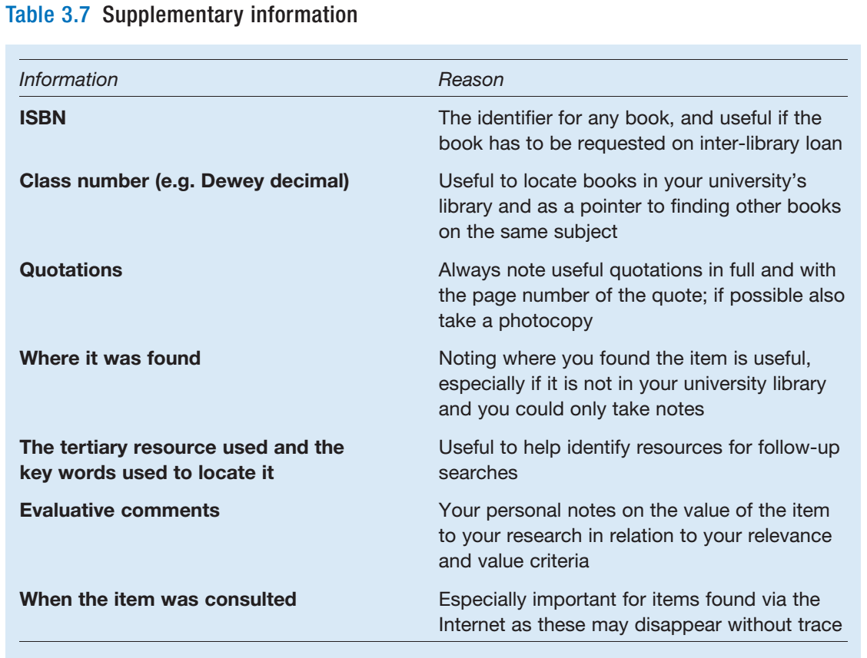

Slide 34
Plagiarism
Four common forms
Stealing material from another source
Submitting material written by another
Copying material without quotation marks
Paraphrasing material without documentation
Adapted from Park (2003), Easterby-Smith et al. (2008)

Slide 35
Summary:
The critical literature review
Sets the research in context
Leads the reader into later sections of the report
Begins at a general level and narrows to specific topics

Slide 36
Summary:
A literature search requires
Three main categories of sources
Clearly defined research questions and objectives
Defined parameters
Use of techniques – ( brainstorming and relevance trees)

